Slide 1
MY-CART
Complete solution for business growth

Slide 2
INTRODUCTION:
It is a web based software designed to solve all major issues faced a customer.
This software provides products to the customer on their fingertips.
It also provides a simple way to manage products for the administrator.
It is a native solution with minimum hardware requirements in turn minimum investment.
Provide proper details of product to sellers and venders.
It helps to track market conditions for particular product to make business more profitable.

Slide 3
CURRENT PROBLEMS
Managing shop rental and human resources is very expensive and hectic.
Offline business requires more resources as compared to offline business.
Searching of a particular product is very hectic in physical market.
Managing inventory is a hectic task, and any mistake will result in stocking of product.
Product can lead to loss if market is down for that particular product.

Slide 4
CURRENT PROBLEMS
Buying and selling product at inappropriate rice.
Time saver for buyers and sellers as well.
Managing expenses of shops, miscellaneous spending is also a hectic task.
Product without description can create problem later.
Digital billing helps to prevent paper records.

Slide 5
OVERCOMING CHALLENGES
My-Cart is the solution for all problem.
Getting remote access to your inventory and account.
Market analysis make our business more profitable.
Resources can be reduced using our web app like staff, space, etc.
Data is more secure, which is only accessible by the owner/user.
Prevent data loss from any disaster or calamity.
Proper management for the inventory and account.

Slide 6
TOOLS AND TECHNOLOGY USED
FRONTEND
HTML
CSS
JAVASCRIPT
BOOTSTRAP
BACKEND
DJANGO
SQLITE3
PYTHON
MACHINE LEARNING FOR ANALYSIS.
TOOLS
VISUAL STUDIO
GIT/GITHUB
CHROME(WEB BROWSER)

Slide 7
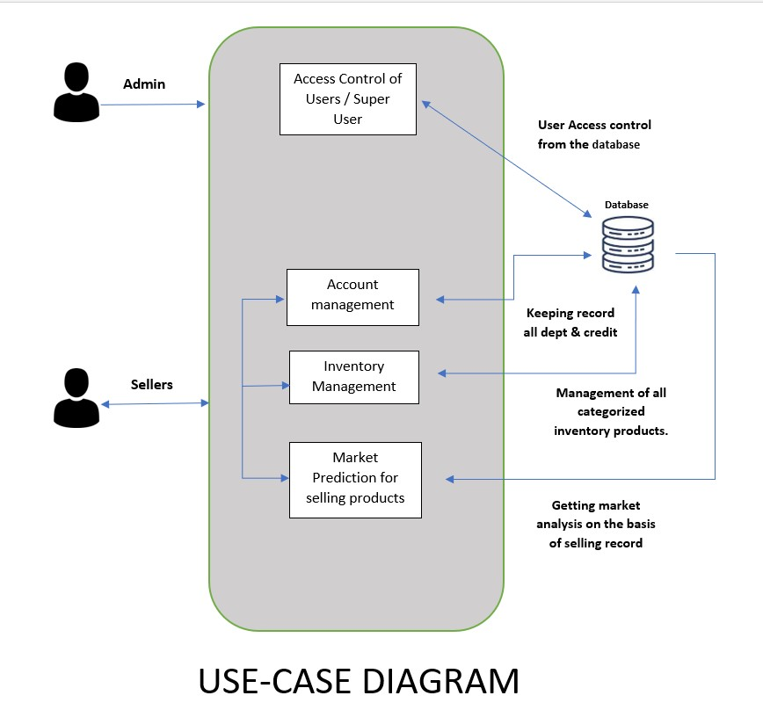
USE CASE DIAGRAM

Slide 8
Features of MY-CART
Admin Perspective
Manage Customer
Manage Inventory
Market Analysis
Product Tracking
Digital Billing
Feedback
Customer Perspective
Search Products
Buy Products
Track Shipment
Feedback
Cart Management

Slide 9
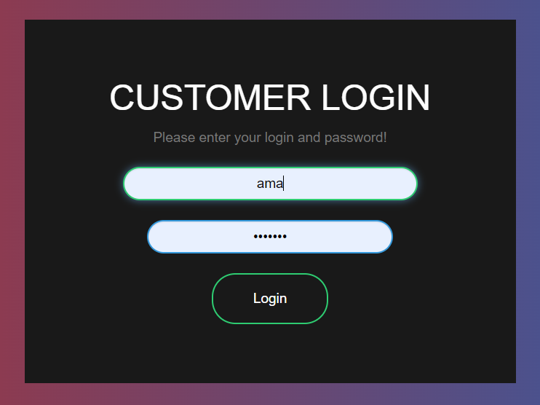
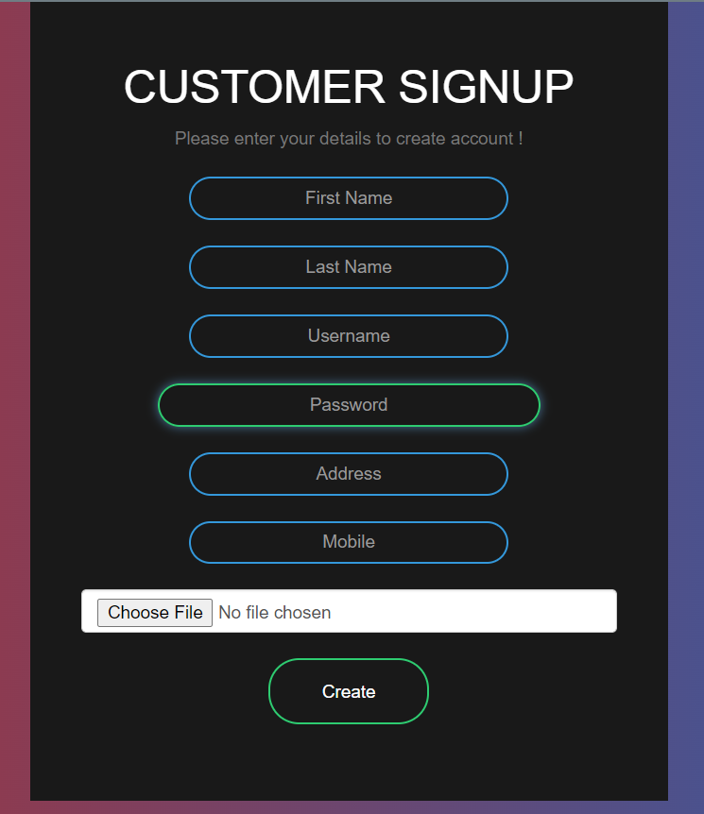
1. Login / SignUp

Slide 10
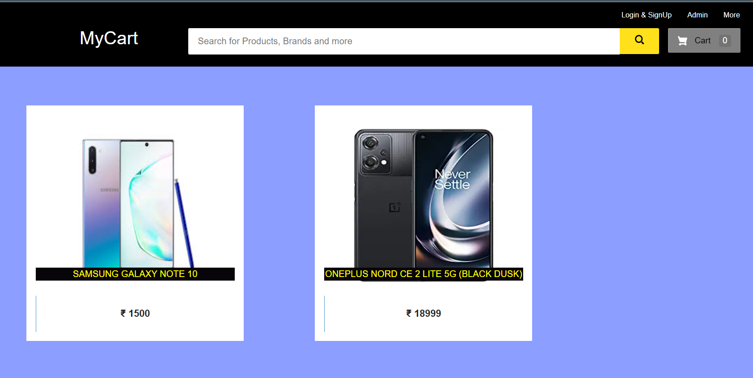
2. Products Searching

Slide 11
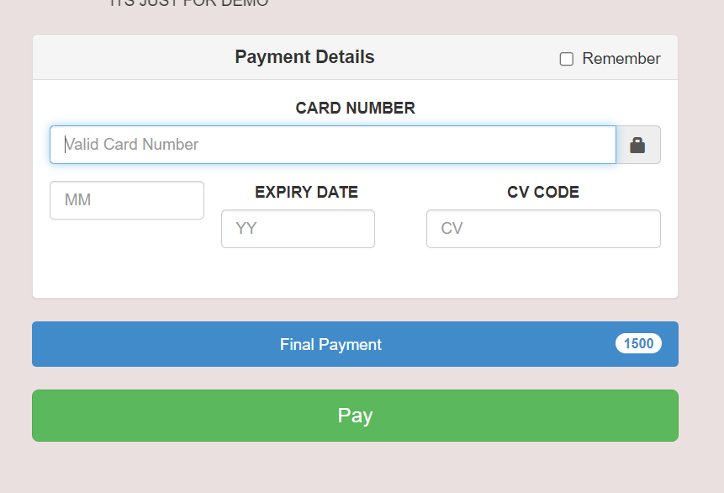
3. Purchase products

Slide 12
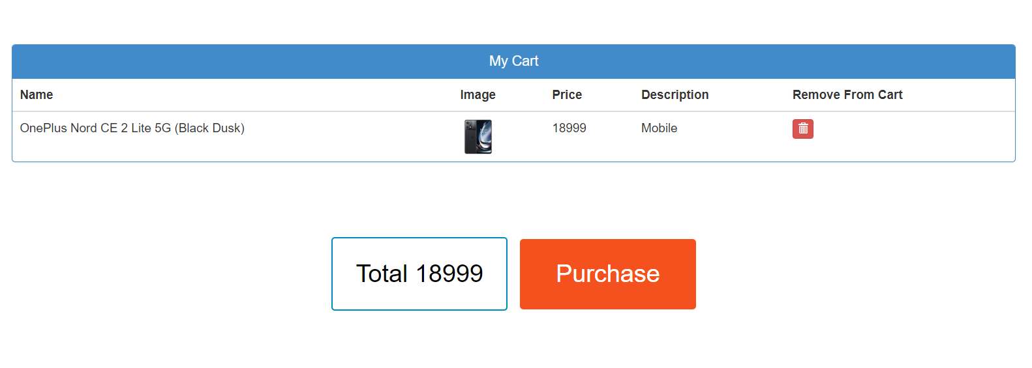
4. Cart Management

Slide 13
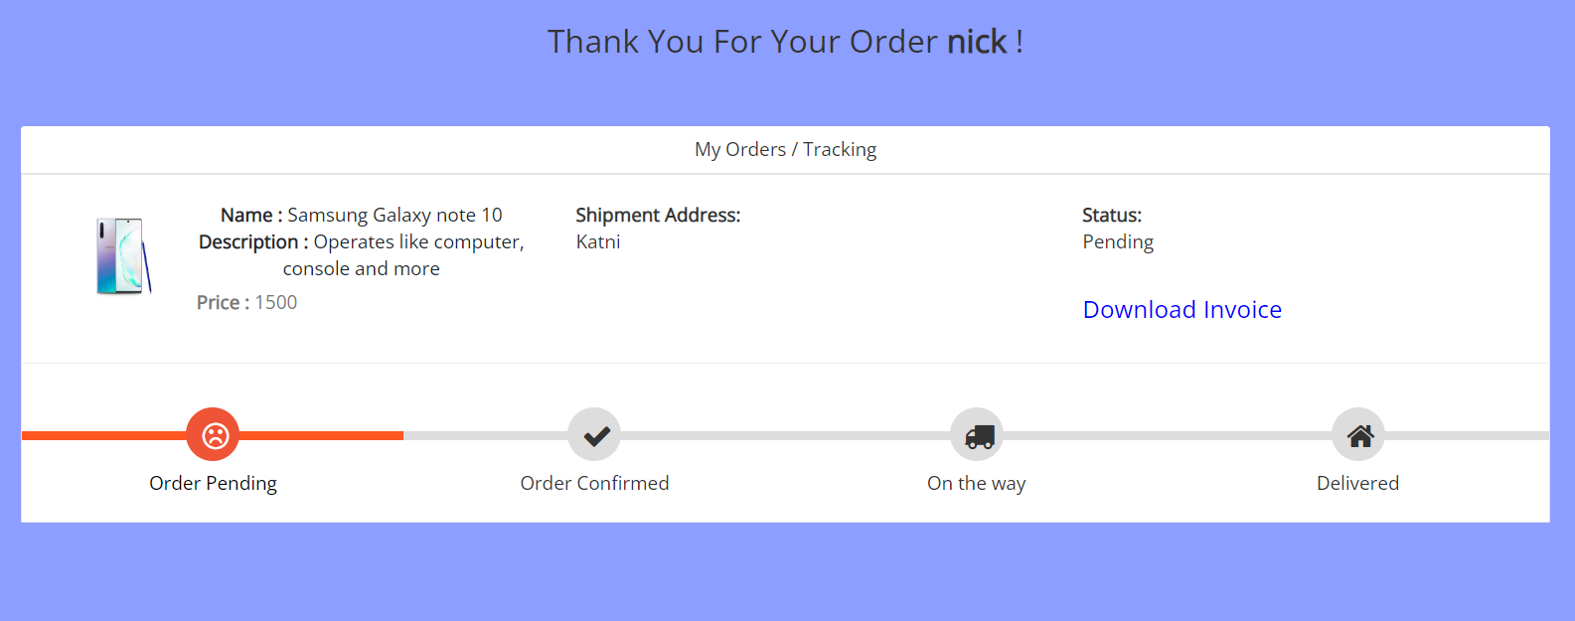
5. Shipment/Tracking

Slide 14
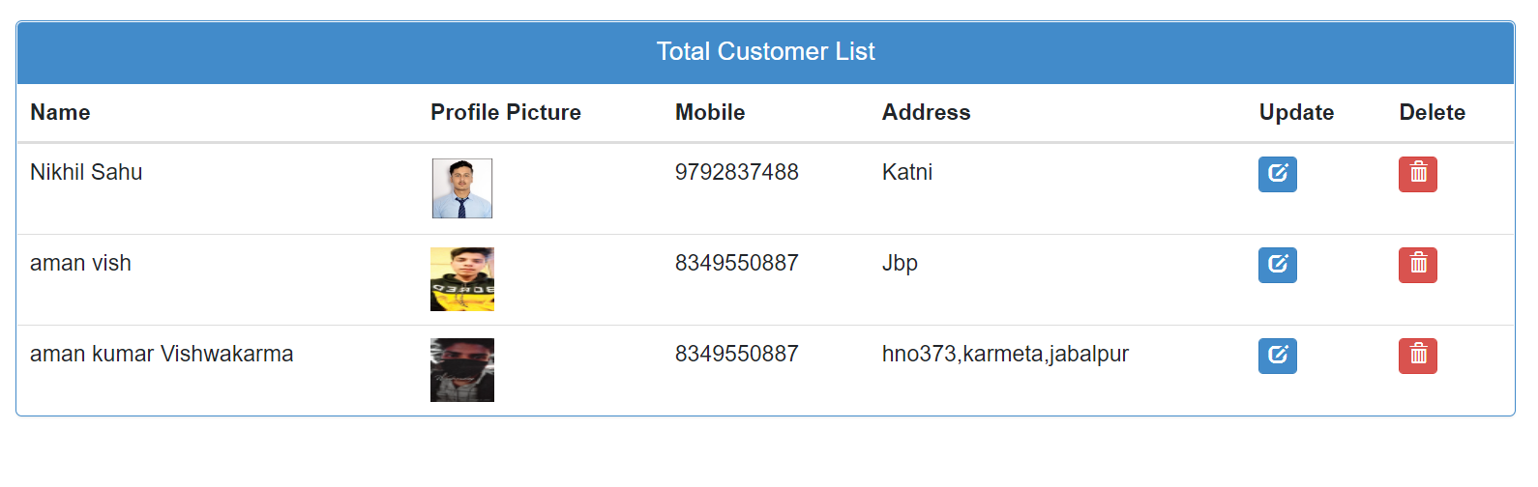
6. Customer Management

Slide 15
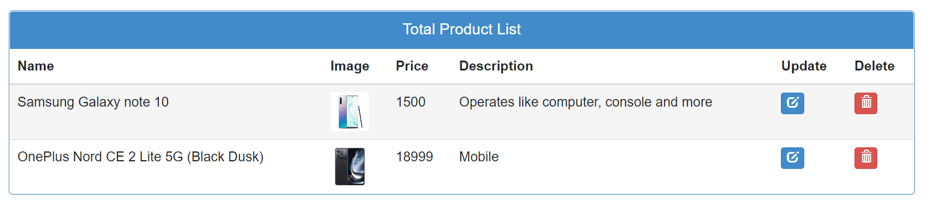
7. Inventory Management

Slide 16
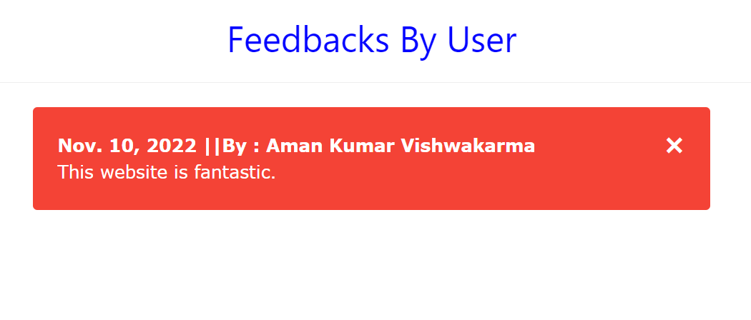
8. Feedback

Slide 17
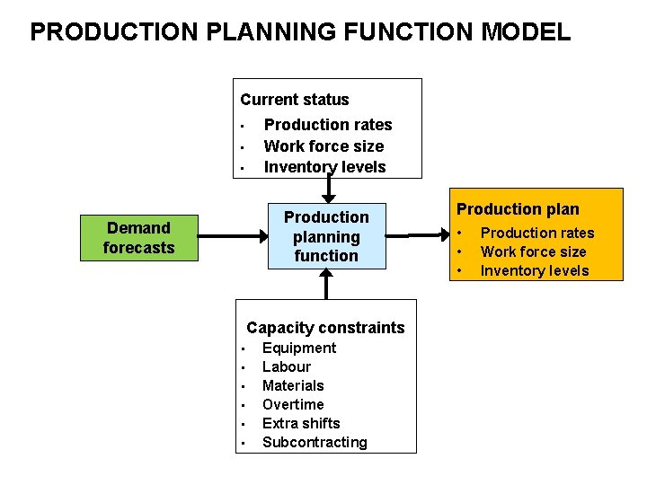
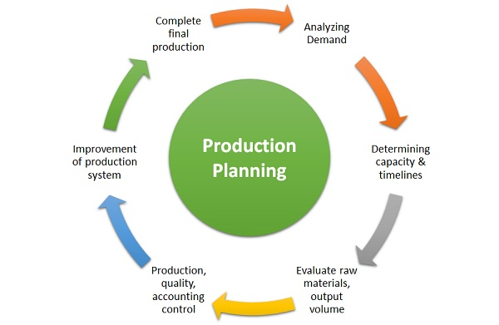
9. Product Analysis.

Slide 18

Thanks!
And regards.

